Slide 1


COMPASS
Computational Photometry Analyzer for Small Satellites

Slide 2
Overview
The Computational Photometric-Characterizer/Analyzer for Artificial Satellites (COMPASS) is a desktop-based rendering engine written in C++ and OpenGL to produce highly accurate graphical representations of RSOs (resident space objects) and their environments as observed by ground-based telescopes. These renderings are generated and processed within the program in order to infer additional information about the system (photometry curve, attitude, rotation, etc.) and provide the user with a convenient and intuitive interface which can be used to visualize the RSO and directly correlate these visualizations to photometry data within the simulations.

Slide 3
Project Requirements
No. | Description
1.0 | The program shall produce accurate renderings of RSO’s.
1.1 | Camera position shall be determined according to the relative locations of the RSO and the telescope.
1.2 | An “up-close” rendering mode shall be implemented to produce accurate brightness data.
1.3 | A “telescope-view” rendering mode shall be available to simulate actual pass observations.
2.0 | The program shall generate accurate photometry curves from simulated RSO passes.
3.0 | The program shall reconstruct the attitude of an RSO given its shape and photometry data.
4.0 | The program shall provide a graphical user interface.
4.1 | The GUI shall be created with QT.
4.2 | The GUI shall provide a render mode to view the RSO renderings.
4.3 | The GUI shall provide a graph mode to view photometry data independently.

Slide 4
Additional Implementations
OSCOM simulator and testing platform. Virtually implementing new utilities/techniques within OSCOM such as OpenCV applications (automatic tracking software) or new equipment (simulate filters, telescope optics, cameras, etc.).
Research aid. Provides a more intuitive understanding of how spacecraft configurations (orbit, attitude, rotation, etc.) correlate to light curve data and provide a means of interacting with the scenario to quickly and easily test/explore new ideas.
CubeSat development. Test CubeSat models and configurations within the software in order to optimize their design for use with OSCOM.

Slide 5
Current State
Written in Java (because I used it for my CS225 project). Will start porting to C++ soon for added performance, using QT windowing/GUI system, OpenGL originally built for C++, and because there’s more support for OpenGL C++ than there is for Java.
Current Capabilities:
loads any STL, AMF, or OBJ model file.
User-set initial orientation/rotation of RSO, pass duration, and sample rate.
Renders RSO according to input parameters.
Measures brightness of RSO (based on pixel color values). Relative change in brightness is accurate, but these don’t correlate to actual units yet…
Displays live graph as RSO is rendered. Saves brightness data and allows it to be graphed again later within the program.
Camera orientation is fixed. In the future, this will be set according to the relative locations of the satellite and observer.
Orbital motion of satellite is not modelled yet. Buttons are there just for show at this point, but I was working implementing this towards the end of the previous semester.

Slide 6
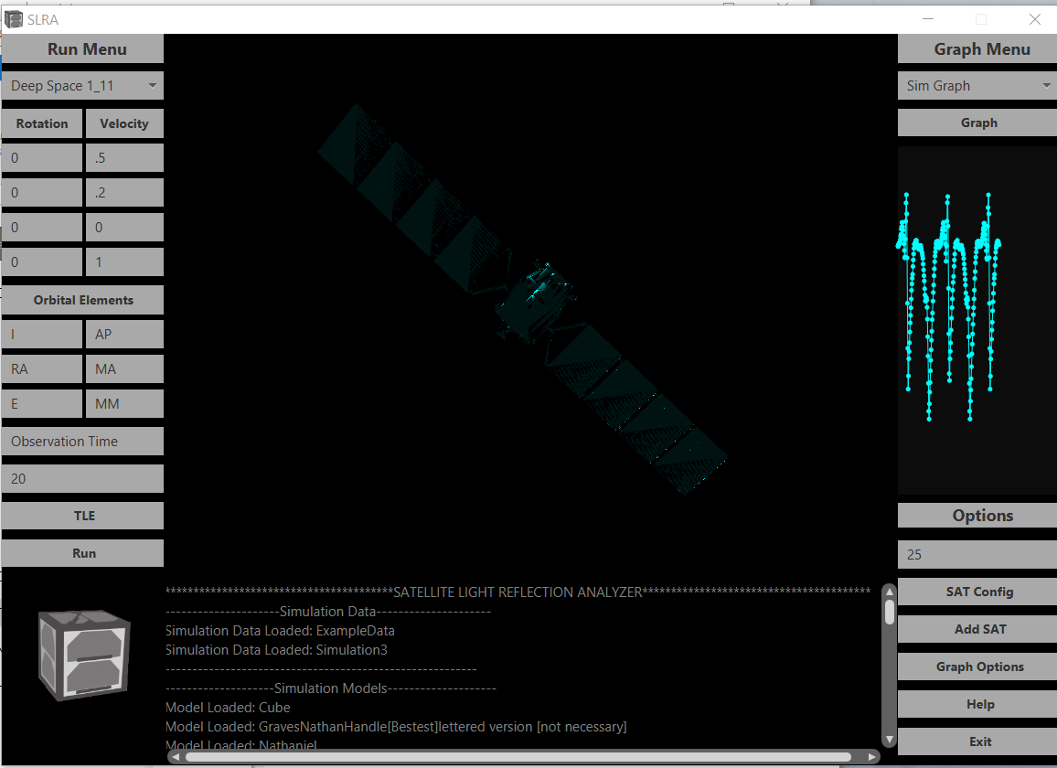
Select data to graph. (new data saved after every simulation)
Select RSO Model
Graph selected simulation in a separate window.
Set Rotation axes for initial orientation and angular velocity
Live graph of RSO brightness. (No units, just shows relative change in brightness for now).
Set initial rotation amount (degrees) or angular velocity (hertz)
Random satellite model from NASA’s website. Default texture is Cyan colored (No particular reason).
Manual orbital elements input… Probably wont use this in the future. Just use TLE
J2000 time of observation. Not implemented yet
Duration of pass. (How long the RSO is rendered)
Does absolutely nothing. Future: set RSO TLE
Sample rate for brightness data. (Hertz)
Run a simulation based on the current parameters
Open a file browser to add a new satellite model.
Output console. Helps with debugging n’ such
Super cool satellite logo that may-or-may-not have been stolen from Spacecraft Development Club…

